Slide 1
Unit-1 Part-4
Proof Strategy and Errors in Proofs

Slide 2
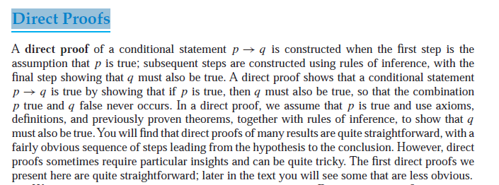


Slide 3
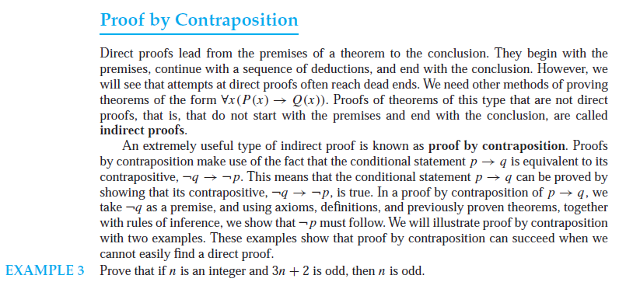

Slide 4
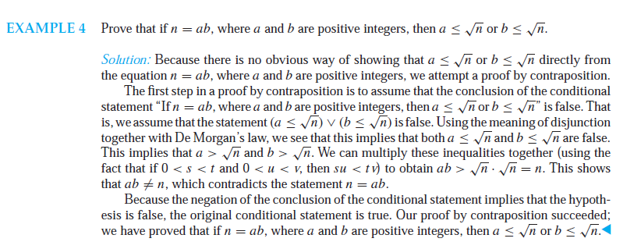

Slide 5
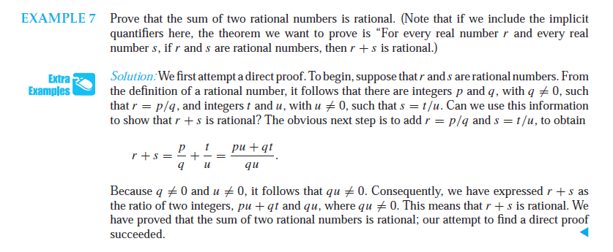

Slide 6


Slide 7
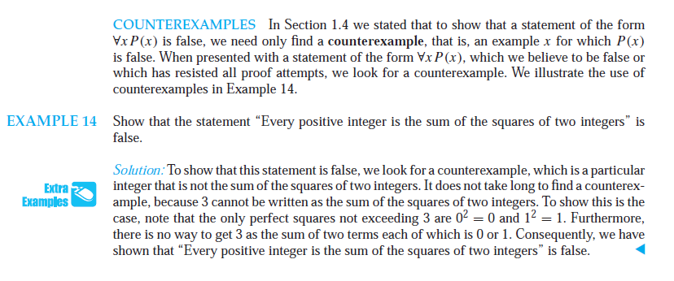

Slide 8


Slide 9


Slide 10
Proofs by Contradiction

Slide 11
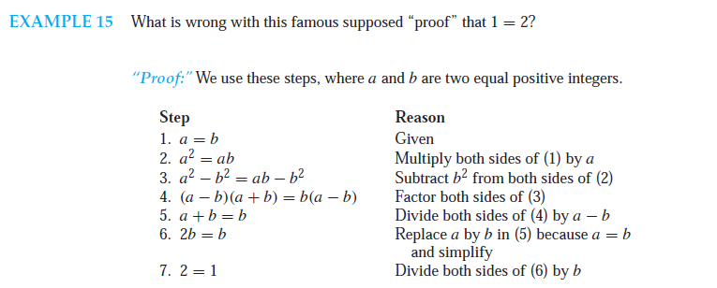
Mistakes in Proofs

Slide 12




Slide 13
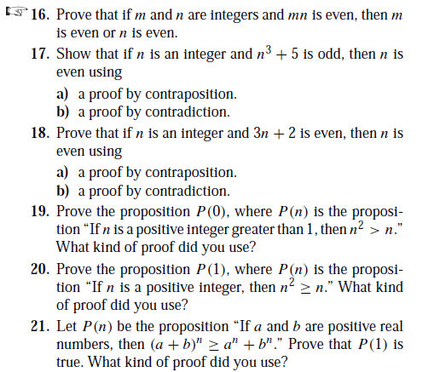

Slide 14
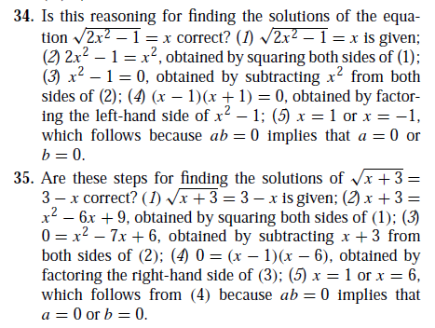

Slide 15
